Slide 1


Income Statement - details
Income Statement - details

Slide 2
Income statement – purpose and structure
Profitability over a period: revenue recognized minus the expenses charged against it.
Revenue minus Cost of revenue
Gross profit minus Operating expenses
Operating profit minus Other expense/income
Pre-tax income minus Provision income taxes
Net Income

Slide 3
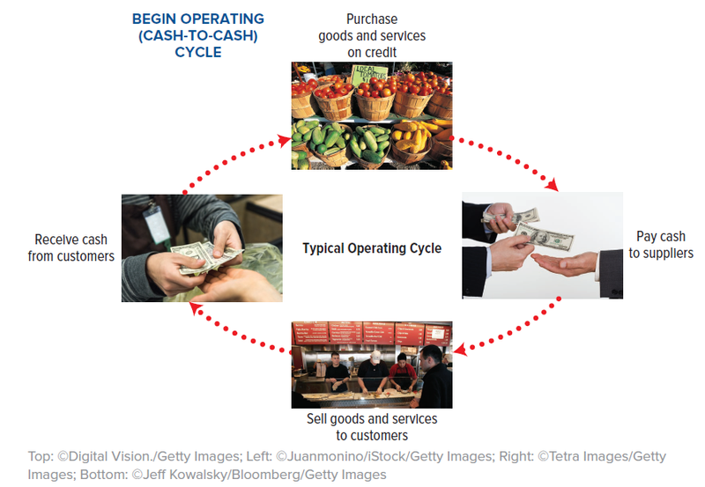
Operating activities at the firm
Operating activities at the firm
Source: Financial accounting, Libby, Libby and Hodge, 10ᵗʰ edition, McGraw-Hill Education

Slide 4
Cash versus Accrual Accounting
Cash versus Accrual Accounting
Cash accounting principle: revenues and expenses are recorded at the time of the cash exchange.
Accrual accounting principle: revenues and expenses are recorded when earned or incurred.
US GAAP requires accrual accounting.

Slide 5
Accrual Accounting – Revenue recognition
Revenue recognized when earned and realized/realizable, not when cash is collected.
Cash may be received . . .
1
before product/service delivery
2
when product/service
is delivered
3
after product/service delivery
TIME
DELIVERY
Record REVENUE here

Slide 6
Accrual Accounting – Expense recognition
Matching principle: record expenses with the revenue generated with them.
Cash may be paid . . .
1
to purchase supplies before being used
2
for repairs the same day (services used)
3
to employees for work in the prior period
USED
(INCURRED to generate revenue)
Record EXPENSE here

Slide 7
Expenses – examples
Expenses – examples
Cost of Goods Sold or COGS - the costs directly tied to the production and sale of the product or service
Operating expenses - NOT directly tied to the production/sales:
  Sales and Marketing
  General and administrative
  Research and development
Non-operating (financial) expenses
Provision for income taxes

Slide 8
Earnings per share (EPS)
Earnings per share (EPS)
EPS = Net income / Shares outstanding — the slice of profit each share owns.
  Basic EPS - based on shares currently outstanding
  Diluted EPS - based on shares currently outstanding, and the net number of shares that may become outstanding in the future.

Slide 9
Income statement – key ratios
Income statement – key ratios
Gross profit margin = (Sales – Cost of Sales) / Sales – product or service profit or unit economics
Operating profit margin = Operating income / Sales – core business profitability
Net profit margin = Net income / Sales – bottom-line profitability
Market price to Earnings (PE) = market valuation multiple

Slide 10
Summary
Summary

Slide 11
Income statement – summary and notes
  The revenues and expenses may be both cash or non-cash.
  The cost of revenues represents the direct cost of production of the product or service sold.
  The operating expenses might not be directly related to the revenues recognized.
  Cash flows for equipment, stock issuance, buybacks, and debt are not on the income statement.
  The income statement may differ from company to company.
  Only material expenses are clearly displayed.

